Slide 1
Leadership Orange
Class XIII
High School Life
Tom Ott - Principal
University High School

Slide 2
Welcome to
University High School!
Opened in 1990
International Baccalaureate and Performing/Fine Arts Magnet
21 Advanced Placement Course Offerings
11 Career Pathways (3 postsecondary)
2,545 students
56% Hispanic
15% African American
14% White Non-Hispanic
10% Asian
291 Students with Disabilities
383 Limited English Proficiency
196 staff members
25 new teachers to UHS or education this year
2,741 total people!

Slide 3
Our Cougar Culture
Every Student, College and Career Ready
Cougar Commitments
Every day…
Student/Staffulty Relationships
We will embody the belief that the student is the most important person on our campus
We will fully communicate with all stakeholders
We will arrive at school ready to support every student and each other
We will deepen our knowledge of each student, their passions, and their goals, and use that information to reach them in their learning
We will model lifelong learning and come to campus with a growth mindset
We will remember that we are in this together and that it takes all of us working together to reach our goals. It’s not about “me.”
Mastery
We will teach grade level curriculum from the first minute of each class period to the last
We will infuse grace and hope into our grading practices in our pursuit of mastery learning
We will require our students to prove their knowledge, we will never assume a student knows something
We will ensure that every student learns as we meet their individual needs
We will value the learning that comes from mistakes

Slide 4
Our Cougar Culture
Every Student, College and Career Ready
Cougar Commitments
Every day…
Student Voice
We will instruct based on how our students learn best
We will ensure student voices are heard in our classrooms as they read, write, talk and/or solve each class period
Celebration
We will be a positive force and extinguish negativity

Slide 5
Our Cougar Culture
Magnet Schools of America Top School of Excellence for our PFA Magnet program in 2023
One of 23 schools nationwide with this distinction
Reduced course failures in ELA (-430) and Math (-384)
Three year reduction in students with two or more early warning indicators
6th highest performing high school in OCPS (3 points from an A)
95% graduation rate
Outperforming our expected student achievement based on our student population in every school grade category

Slide 6
Turn and Talk
What does a High School Principal do all day anyway?
Did you know your Principal when you were in high school?

Slide 7
Leading a School
Safety and Security
Core Instructional Program
Student Management
Scheduling
Hiring/Staffing
Staff Evaluations/Observations
Labor Relations
Opening opportunities for students (athletics, clubs, etc.)
Branding/Advertising
Improvement Planning
Systems Implementation
Communication
Community Partnerships
Stakeholder Questions/Concerns
Compliance Reporting
Budgeting
Any and Everything!

Slide 8
Leading a School

Slide 9
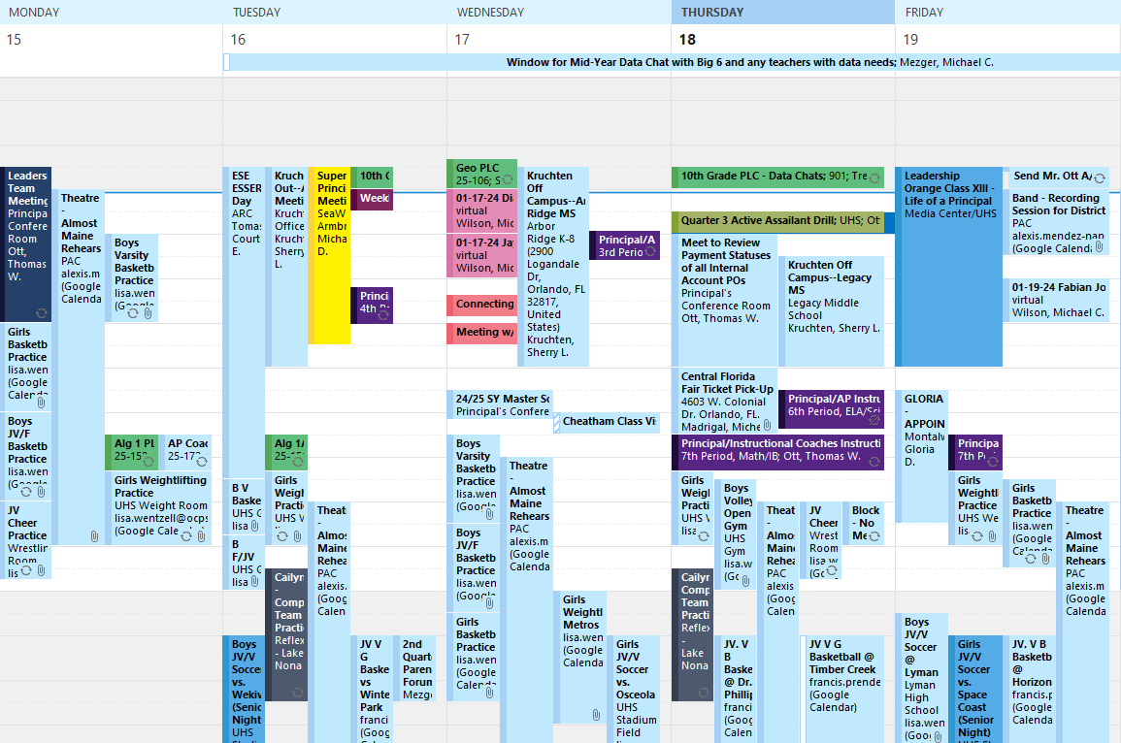
Leading a School

Slide 10
Leading a School
However, the #1 Priority is Student Success…and all students are different.
So….the Principal needs to
Put the right people in the right seats
Create the right conditions for learning

Slide 11
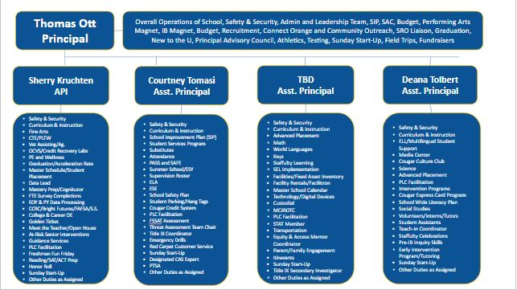
Putting the Right People
in the Right Seats

Slide 12
UHS Master Schedule

Slide 13
Master Scheduling Considerations
Plan Periods
You need to look at all departments to keep a count of Plan Periods for each period–you can only have so many teachers on planning at one time
Choose teachers based on the needs of our students and not their preference
Utilize class data when making these decisions
Specialty Classes
This has to be built first before we can place the other classes
Number of sections will be based on the course requests
Course Request process begins in January
Are there any courses that you want to add or delete?
Consider Psychological and Physiological needs of students

Slide 14
Putting the Right People
in the Right Seats

Slide 15
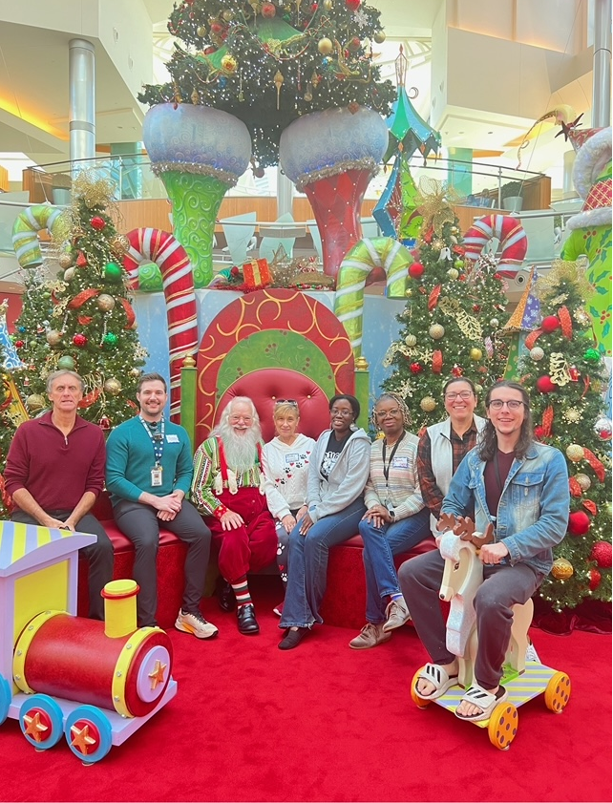
Putting the Right People
in the Right Seats

Slide 16
Putting the Right People
in the Right Seats
How many Algebra 1, Algebra 1 Honors, and Algebra 1A teacher's do I need?
(Teachers have 6 class periods a day and one planning period)

Slide 17
Creating the Right
Conditions For Learning
Multiple Pathways
CTE
College and Career Dual Enrollment
IB and AP
PFA
Instructional Practices
Student Voice (process, elaborate, problem solve, critically think)
Grading Practices
Mastery
Student Expectations
Tardy and Attendance Policy
Golden Ticket
Leadership Expectations
Leadership Team Rules of Engagement
How do we meet EVERY students individual needs?

Slide 18
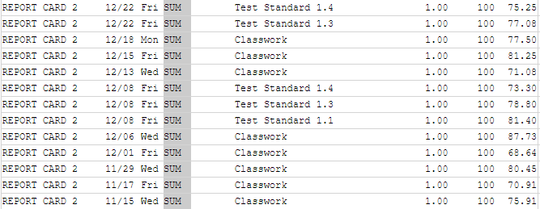
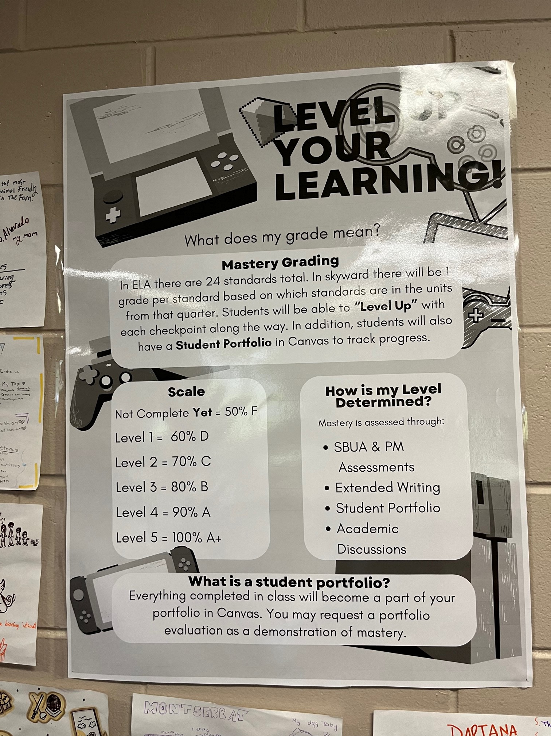
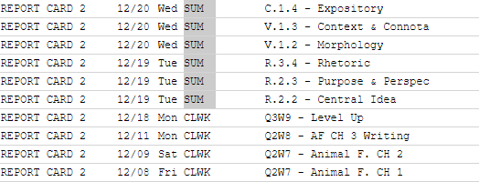

Slide 19
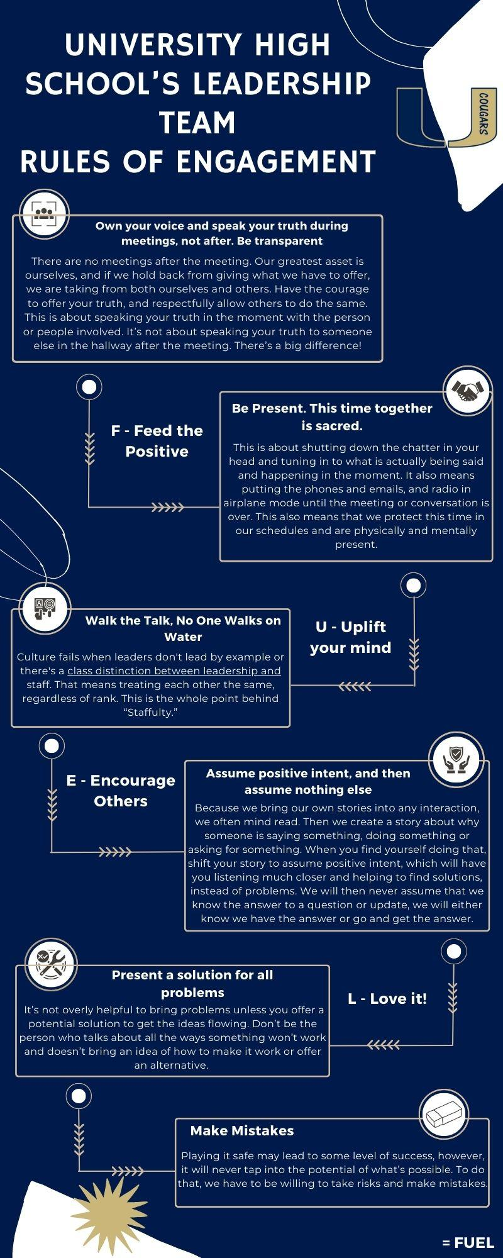

Slide 20
Student Needs Activity
A 9th grade student who has been “on the radar” since the start of school has consistently begun to receive referrals for skipping 2nd and 3rd period.

Slide 21
As you begin to process the referrals, you notice that all of the referrals are coming from his second or third period teacher…

Slide 22
As you pull up this students schedule, you realize that his second period class is Algebra 1 and his third period class is HOPE…

Slide 23
You also realize that his brother, a junior has been showing up to all of his classes…

Slide 24
Further research shows that attendance is excellent fourth period through seventh period…

Slide 25
You decide to speak with the students teachers…you ask…

Slide 26
You find the student during fourth period the next day and bring him in to process the referral…what conversation do you have with the student?

Slide 27
Cougar Future Fair
Wednesday, April 24th, 2024
7:00 am to 1:15 pm
Participants will be able to meet our 11th and 12th grade students eligible for internships, employment, and other such opportunities
Interested? Let Mr. Ott know or contact our College and Career Counselor, Patrick O’Donal at
Patrick.Odonal@ocps.net

